Slide 1
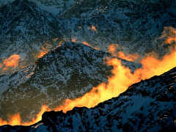
Identify the reaction
Does this reaction absorb heat?
Does this reaction release heat?
Is this an exothermic or endothermic reaction?

Slide 2
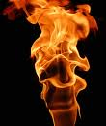
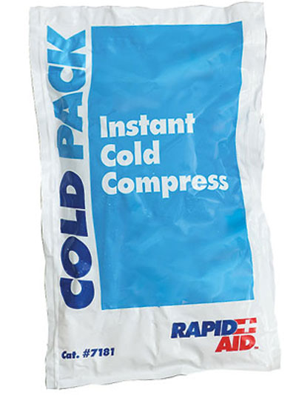
Chemical Energy Effects
All chemical reactions involve an energy change.
The transfer of energy, usually heat, into or out of the reaction mixture’.
e.g. when petrol burns
heat is given out. (Exothermic)
When ammonium nitrate dissolves in water heat is taken in. (Endothermic)

Slide 3
Instead of writing ‘energy change’ all the time chemists use the symbols
ΔH
Δ = Greek letter ‘delta’ meaning change.
H = Enthalpy (heat of reaction)
Enthalpy is Stored Chemical Energy.
So, ΔH means ‘change in enthalpy’.

Slide 4

Temperature Changes
Some reactions cause the temperature of the reaction mixture to increase.
This type of reaction is called exothermic.
Heat energy is given out by the system (reaction mixture) hence the surroundings increase in temperature

Slide 5

Temperature Changes
Some reactions cause the temperature of the reaction mixture to decrease.
This type of reaction is called endothermic.
Heat energy is taken in by the system (reaction mixture) hence the surroundings decrease in temperature.

Slide 6
Representing Energy Changes:
The energy changes in a chemical reaction can be conveniently represented using
Enthalpy or Energy Profile diagrams
Energy level diagrams make it easier to decide whether a reaction is exothermic (gives out heat and gets hotter) or endothermic (takes in heat and gets cooler).

Slide 7


Enthalpy Diagrams
This energy profile diagram shows a reaction where
ΔH is negative
(an exothermic reaction).
This energy profile diagram shows a reaction where
ΔH is positive
(an endothermic reaction).
Reactants
Products
ΔH negative, exothermic.
energy
ΔH positive, endothermic.
energy
Reactants
Products

Slide 8
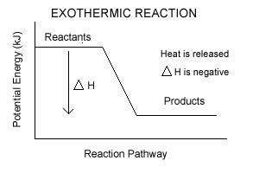
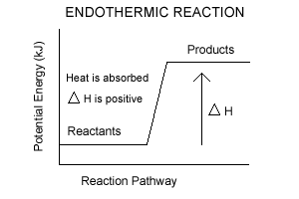
Another version may look like . . .

Slide 9
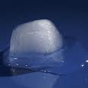
Phase changes and Enthalpy
Ice melting to water
Requires energy to be added to the system from the surroundings.
(absorbing energy to make the reaction happen is an “Endothermic” process.)
H₂O_{(s)} → H₂O_{(l)}

Slide 10
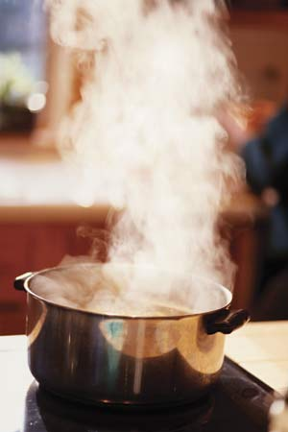
Phase changes and Enthalpy
Water boiling to form steam
Requires energy to be added to the system from the surroundings.
(absorbing energy to make the reaction happen is an
“Endothermic” process.)
H₂O_{(l)} → H₂O_{(g)}

Slide 11
Phase Changes and Enthalpy
exothermic
enthalpy
gas
Liquid
endothermic
Solid

Slide 12
Making and Breaking Bonds:
Breaking chemical bonds is usually endothermic.
Making chemical bonds is usually exothermic.
All chemical reactions involve bond ‘rearrangements’. Bonds are broken and new ones are formed.
Chemical reactions are in two stages:
Breaking bonds, an endothermic process.
Making new bonds, an exothermic process.

Slide 13
Reaction Profiles are
More detailed version of the energy level diagrams;
They show the endothermic bond breaking and the exothermic bond making stages of a reaction.
Reaction profiles can be used to do numerical calculations on the energy changes that happen in chemical reactions.

Slide 14

Reaction Profile for
H₂ + Cl₂ → 2HCl
Energy taken in to break bonds.
H, H, Cl, Cl (Atoms)
Energy given out when bonds are made.
H-H, Cl-Cl
energy
Reactants
Overall energy change, ΔH
H-Cl, H-Cl
Products

Slide 15
Calculating Energy Changes:
The energy change for a reaction can be calculated using ‘bond energies’.
‘Bond energy’ is the amount of energy required to break a bond. This value is usually endothermic, ie. has a positive value.
When a bond is formed the energy given out is exactly equal to, but of opposite sign, to the energy required to break the bond. Bond making is usually an exothermic process.
.

Slide 16
Reaction Profile for
H₂ + Cl₂ → 2HCl
Energy taken in to break bonds.
H, H, Cl, Cl (Atoms)
Energy given out when bonds are made.
H-H, Cl-Cl
energy
Reactants
Overall energy change, ΔH
H-Cl, H-Cl
Products

Slide 17
An Example Calculation
Consider the reaction between hydrogen and chlorine
H₂ + Cl₂ → 2 HCl
Breaking Bonds:
1 H-H bond and 1 Cl-Cl bond
The H-H bond energy is 436 kJ/mol
The Cl-Cl bond energy is 242 kJ/mol
So, the energy needed to break these bonds is
436 + 242 = 678 kJ

Slide 18
H₂ + Cl₂ → 2 HCl
Making Bonds:
H-Cl bond energy is 431kJ released (-ve)
So the energy given out when these bonds are
formed is 2 x - 431 = - 862 kJ
Overall change
ΔH = H_{products} - H_{reactants}
= - 862 - 678
= - 184 kJ,
an exothermic reaction

Slide 19
Reaction Profile for
H₂ + Cl₂ → 2HCl
Energy taken in to break bonds.
H, H, Cl, Cl (Atoms)
Energy given out when bonds are made.
H-H, Cl-Cl
energy
Reactants
Overall energy change, ΔH
H-Cl, H-Cl
Products

Slide 20
Summary
Endothermic reactions get cold,
they take in heat.
This may make your hand feel cold if you touch the reaction vessel.
Exothermic reactions get hot, they give out heat.
This may burn your hand if you touch the reaction vessel.

Slide 21
Chemical reactions take place in two stages:
Summary
Bond breaking is endothermic, bond making is exothermic.
An endothermic bond breaking stage.
An exothermic bond making stage.
The ‘energy changes’ in a chemical reaction can be represented using enthalpy diagrams and reaction profile diagrams.

Slide 22
References
http://molecularmaidens.blogspot.com/2010_01_01_archive.html
http://www.chemicalconnection.org.uk/chemistry/experiments/list.php
http://faculty.sdmiramar.edu/fgarces/zCourse/All_Year/Ch100_OL/aMy_FileLec/04OL_LecNotes_Ch100/09_KineticsEquil/901_Kinetics/901_Kinetics.htm
http://drmccarthysciencehgms.blogspot.com/2010/03/synthesis-decomposition-single-double.html
http://www.docbrown.info/page03/3_51energy.htm

